Slide 1
UNIT-1
18CSE44T-ENERGY MANGEMENT FOR INTERNET OF THINGS DEVICES

Slide 2
Introduction to IoT
The Internet of Things is the concept of connecting any device to the Internet and to other connected devices.
Network of connected things and people – all of which collect and share data about the way they are used and about the environment around them.
How does it work?
Devices and objects with built in sensors are connected to an Internet of Things platform, which integrates data from the different devices and applies analytics to share the most valuable information.
This information can be used to detect patterns, make recommendations, and detect possible problems before they occur.

Slide 3
Definition of IoT
“IoT is an interaction between the digital and physical worlds using an abundance of actuators and sensors”.
“IoT can be defined as embedding computing and networking capabilities in various types of object”.

Slide 4
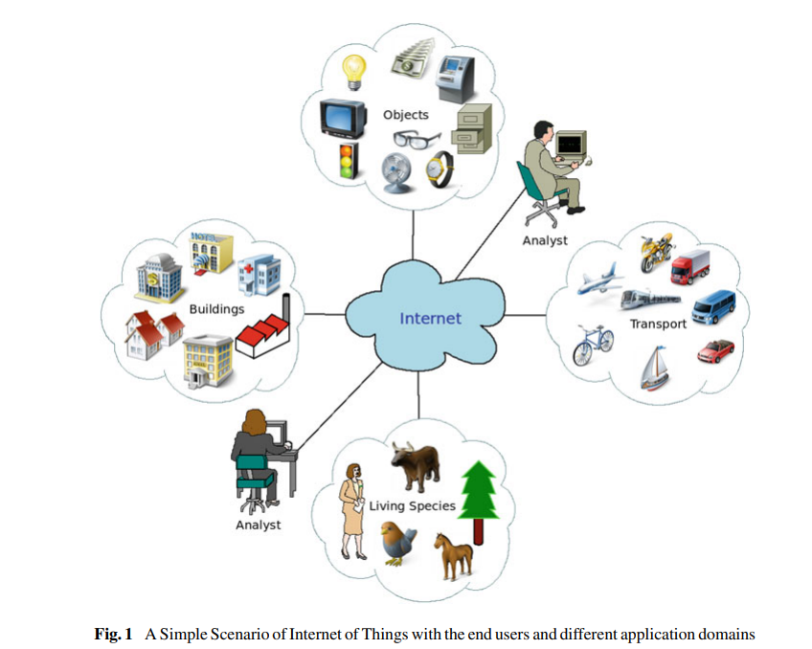
An example of scenario of Internet of Things with different application domains of IoT

Slide 5
Architectures of IoT
Three-Layer Architecture:
The three layers in this architecture are: the perception, network and application layers
Perception Layer: This layer is similar to physical layer in OSI model and also known as “Device Layer”.
The aim of this layer is identification, tracking, information acquisition, and processing from the environment.
various types of physical devices and sensors such as Zigbee, Infrared, RFID, QR code, etc. are used to monitor physical world and collect the data.
Information collected is transmitted to network layer for secure communication

Slide 6
2. Network Layer:
This layer provides the facility to connect with other smart objects. This layer is also responsible for routing and secure data transmission through Wi-Fi, 3G, infrared, Bluetooth, UMTS, Zigbee, RFID, Satellite, WiMAX, etc.
IEEE 802.15.4, 6LoWPAN, Zigbee, Z-Wave, etc., are some protocols for secure and reliable communication in IoT.
3. Application Layer:
The information received from the lower layer is managed by respective management system and services specific to application are delivered to the user.

Slide 7
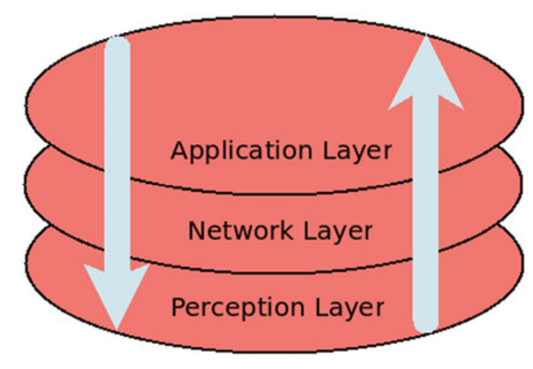
Three-layer architecture

Slide 8
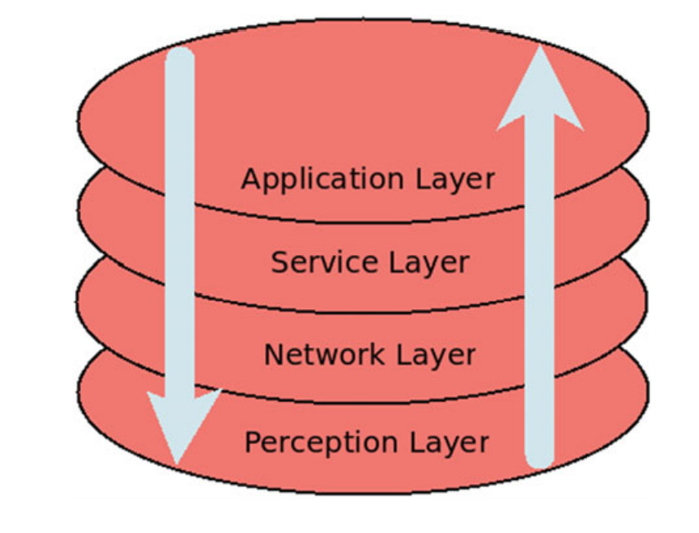
Four Layer Architecture:
The four layers are enlisted as 1. Perception Layer 2. Network Layer 3. Service Layer 4. Application Layer
Service Layer
In service layer, various enabling technologies are exploited to ensure the efficient service provision. These technologies are interface, resource management and sharing, middleware and service management

Slide 9
Five-Layer Architecture
The five layers are enlisted below. 1. Perception Layer 2. Transport Layer 3. Processing Layer 4. Business Layer 5. Application Layer.
1. Transport Layer:
This layer transmits the collected data from lower layer to upper layer securely and vice versa via 3G, 4G, LAN, Bluetooth, NFC, RFID, etc.
2. Middleware Layer:
Middleware layer is also known as “Processing Layer”. This layer performs service management and data storage
This layer is capable of making decision based on the results of computational automatically.
Technologies like databases, big data processing, and cloud computing are employed by this layer.

Slide 10
3. Business Layer:
it can make business models, reports, flowcharts, graphs, etc.
Depending on analysis, it also helps in making more precise decisions about the roadmaps and strategies of business

Slide 11
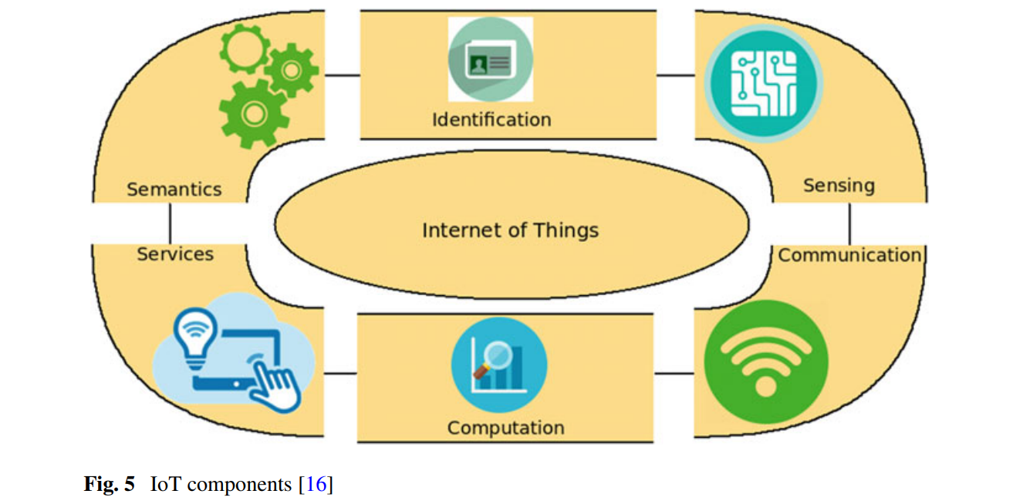
Components of IoT

Slide 12
Components of IoT
Identification
Things, already connected or going to be connected, need to be uniquely addressable.
Various techniques are available for IoT identification like ubiquitous codes (uCode) and electronic product codes (EPC)
it is required to differentiate between the device address and its ID for addressing the IoT devices. Device’s ID is name assigned to it.
device address represents its address to identify it within a communications network

Slide 13
IPv4 and IPv6 are protocols used for addressing purpose of IoT objects.
Sensing:
Sensing in IoT system means acquiring data from the environment or other related objects within the network.
Gathered data is transmitted to databases, data warehouses on the cloud and analysed for taking the decision required to provide some services.
The IoT sensors include smart sensors, actuators, RFID tags or wearable sensing devices

Slide 14
Communication:
Communication technologies in IoT are used to make the connection between the heterogeneous devices so that they can deliver the specific service together.
Various IoT communication protocols are IEEE 802.15.4, Near Field Communication (NFC), LTE-Advanced, Bluetooth, Zigbee, Wi-Fi, Z-wave, RFID, Ultrawide bandwidth (UMB), etc.

Slide 15
Computation:
The data collected by the IoT devices need to be processed for the analysis and decision-making.
For this purpose, some processing units (e.g., microcontrollers, microprocessors, SOCs and FPGAs) and software applications are needed which act like the “brain” of IoT and have computational ability.
Arduino, Raspberry PI, WiSense, and Cubieboard, etc. are the several hardware platforms developed to execute the IoT applications
Riot OS, Contiki, LiteOS and TinyOS are the lightweight OS developed for IoT environments.
Cloud platform are also part of IoT computation as they provide facility for big data processing on cloud.

Slide 16
Services:
IoT provides various types of services. Broadly these services can be classified into four different classes:
Identity-related: to identify the connected objects
Information Aggregation: to acquire and sum up the raw data which is further processed
Collaborative-Aware: utilize the obtained data for making smart decision and act accordingly.
Ubiquitous Services: provide these services to anyone anywhere

Slide 17
Semantics
semantic means the capability of extracting knowledge smartly via various machines so that the required service can be provided to the users.
Semantic Web technologies, like Web Ontology Language (OWL) and Resource Description Framework (RDF) support this requirement.

Slide 18
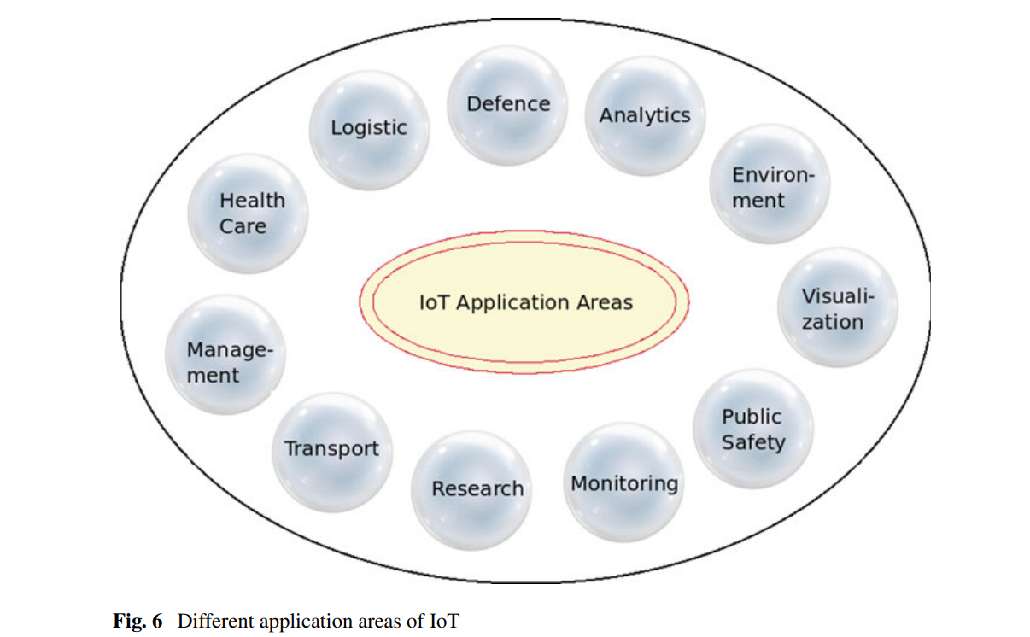
Applications

Slide 19
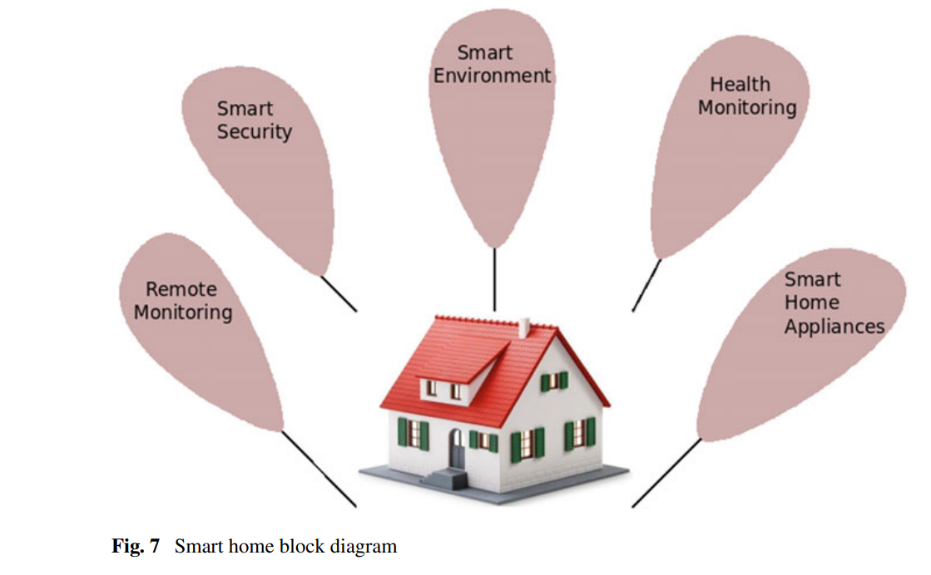
Home Automation

Slide 20
Health care
IoT is providing the benefits to people by monitoring their health regularly, managing their medicines, and also contact with doctors and family in emergency.
Transportation
Smart transportation, which helps in managing daily traffic, is implemented by embedding sensors into vehicles, traffic light, roads, etc.
These sensors assist in monitoring the vehicles breaching the traffic rules, environment pollution control, traffic congestion reduction, law enforcement, intelligent parking, etc. Block diagram of smart parking system

Slide 21
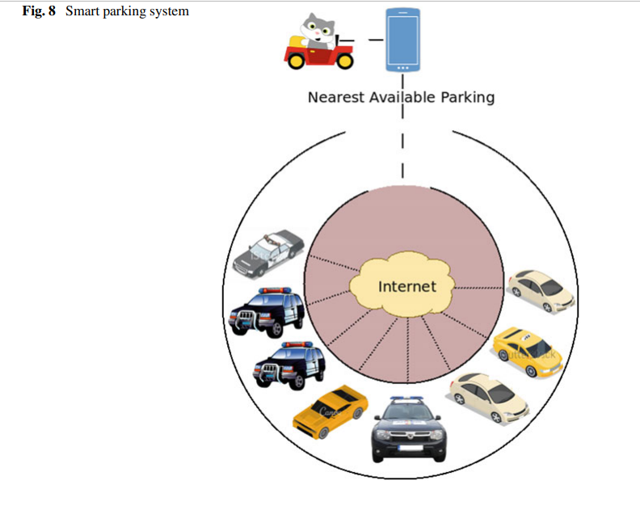

Slide 22
Logistics
monitoring of all most supply chain including commodity design, purchasing of raw materials, production, transportation, distribution, sale, etc.
Smart Environment and Agriculture
A group of sensors can be deployed by farmers to identify various land requirements like humidity, soil information and temperature.
IoT based applications help in monitoring and controlling the air pollution. To measure the air pollution, electrochemical toxic gas sensors can be used.

Slide 23
Challenges in IoT
Security:
IoT faces some security challenges which are Privacy, Authentication, Trust, Confidentiality, Policy enforcement, Access control, etc.
Security challenges encountered at different layers of IoT architecture are:
a. Perception Layer: As the perception layer focuses on data collection, security challenges at this layer are Node Capture, Eavesdropping and Interference, False Data Injection, Cryptanalysis and Side Channel, Malicious Code Injection, Replay Attacks, Sleep Deprivation Attacks, etc.

Slide 24
b. Network Layer: As the network layer focuses on data transmission, security challenges at this layer are related to availability of network resources and wireless networks. These are Denial-of-Service (DoS) Attacks, Man in the Middle Attack, Wormhole Attacks, Sinkhole Attacks, Spoofing Attacks, Routing Information Attacks, Sybil Attacks, Unauthorized Access, etc.
c. Application Layer: As the application layer focuses on service support, challenges faced are related to software attacks. These are Phishing Attack, Malicious Scripts and Virus/worm, etc.
2. Standardization: there is no standard framework, even though many standards for IoT like Zigbee, Wireless Hart, M2M, NFC, ROLL, etc. are evolved.

Slide 25
3. Addressing:Available IPv4 addresses are exhausting rapidly since the number of IoT devices are increasing rapidly
4. Transport Protocols: TCP protocol cannot be used effectively in the IoT, due to congestion control and connection setup.
5. Traffic characterization and QoS support: A huge amount of traffic will be generated by IoT having various patterns.
6. Energy Efficiency:The key characteristic of IoT devices is the power limitation.
Many sensors are powered via battery without recharging. Frequent battery replacement for the sensors exploited in the outdoor territories can cause to a significant expenditure.
IoT devices are growing rapidly and this rapid increment of IoT is causing significant energy consumption

Slide 26
Energy Management
A sensor node consists of:
(i) Sensing subsystem
(ii) Processing subsystem
(iii) Communication subsystem
(iv) Power source.
Among all these subsystems, the communication subsystem requires more energy on average than the other subsystems
Most of IoT devices are battery driven, economical deployment and maintenance of these sensors is one of the challenge.
Moreover, battery replacement is also important issue for sensors.

Slide 27
Energy Management
Hence, low power consuming sensor designs or techniques are required for energy efficiency
To solve this problem, we need to manage energy in IoT devices , energy management can be done via energy harvesting or energy conservation
Energy Harvesting: In this technique, ambient energy is scavenged from available energy in our surrounding like solar, wind, hydro, etc and converted into useable form.
Energy Conservation: Another technique is energy conservation which focus on the reduction of energy consumption in IoT devices. There are many schemes to conserve the energy like duty cycling, data reduction, etc.

Slide 28
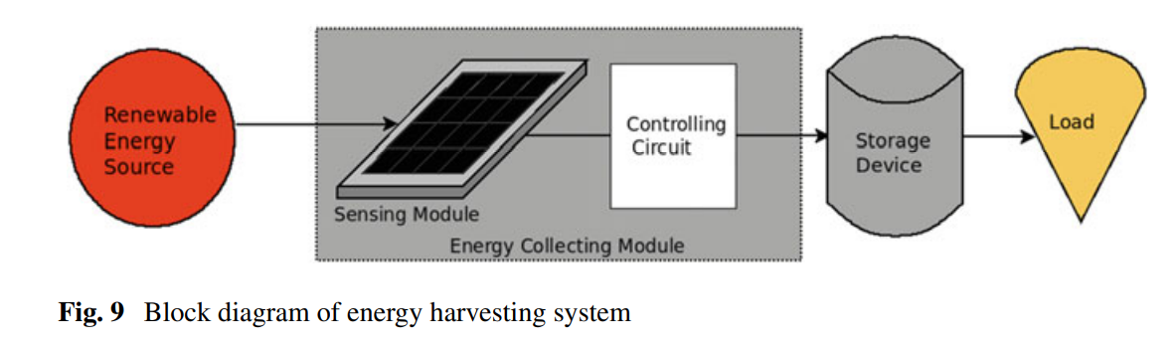
Energy Harvesting:
Energy harvesting techniques are used to acquire energy from the renewable resources.
Energy harvesting device transfer the energy into electrical energy for the use.

Slide 29
The component of an energy harvesting system is:
1. Energy Source:
2. Energy Collecting Module: This module obtains the energy from the surrounding and converts it into useable form
a. Sensing Module: solar panel
b. Controlling Circuit: After harvesting the energy, it needs to be converted into electricity (Oscillator and rectifier circuits )before use. After this, electrical power need to be regulated by the internal circuitry.
3. Storage Device: This power can be delivered to load directly or via storage device. Examples: Pumped Hydroelectric Energy Storage (PHES), Battery Energy Storage (BES), etc.
4. Load.

Slide 30
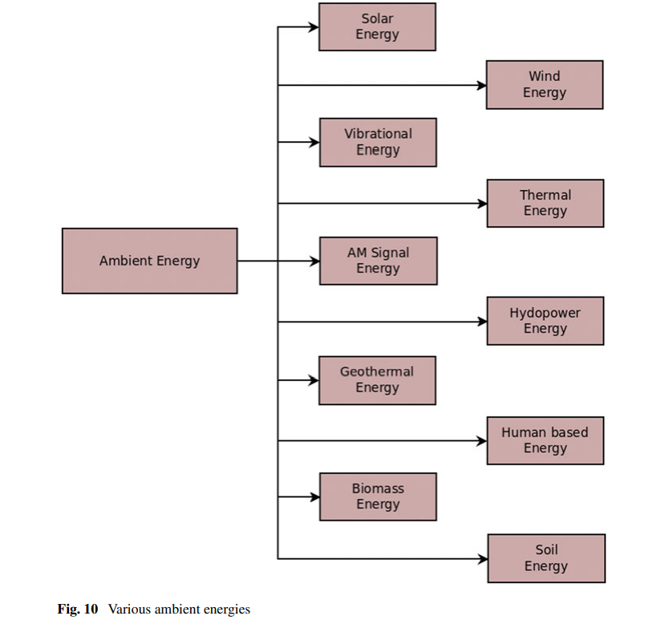
Ambient Energy
Ambient energy is the base of the energy harvesting concept.

Slide 31
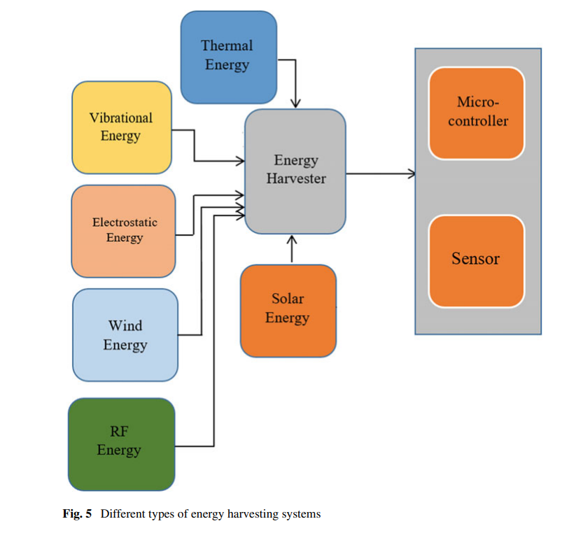
Energy harvesting systems

Slide 32
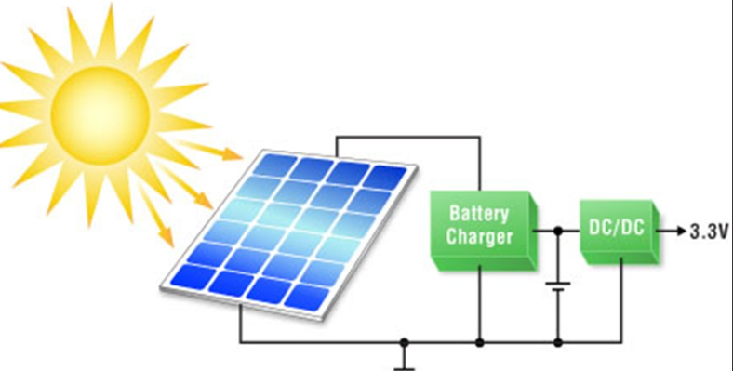
Energy harvesting systems
Solar Energy Harvesting
The solar energy harvesting system is the most commonly used method because of the easy accessibility of solar energy.
Normally, the semiconductor diode based photovoltaic cells are used to convert light energy or solar energy into electrical energy; sometimes infrared or ultraviolet rays are also used for conversion.
By connecting several photovoltaic cells in a series and parallel configuration, the high efficiency solar panels can be constructed. But the main drawback of this source of energy is the limited availability of sun in the daytime only.
On an average, the sun is available for four to eight hours and based on the principle of photovoltaic effect the sun radiations can be
converted into useable power.
The other demerits of solar harvesting system
are high installation and operating cost,
low output efficiency, and bulkier panels.

Slide 33
Energy harvesting systems
Thermal Energy Harvesting
Thermal energy can be directly converted into electrical energy through the principle of the Seebeck effect or Thomson effect. Another type, popularly known as Peltier effect.
In the Seebeck effect or Thomson effect, the electrons from the heated conductor flow towards the cooler conductor and if the two pairs of metals are directly connected through some electrical circuit the voltage generated can be consumed directly
The direct current (DC) voltage generated by this system will be very small (in microvolts) and to increase the magnitude of generated voltage, an array can be used. These devices are called as thermoelectric devices
Unlike solar energy, thermal energy is available all the time but it needs a large area and the power produced is low.

Slide 34
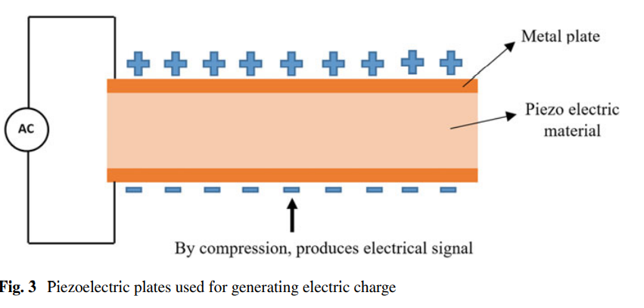
Energy harvesting systems
Vibrational Energy Harvesting
This method converts mechanical energy into electrical energy by means of applying stress. push, or squeeze and the mechanical strains may be of any type either vibration or any deformation of material.

Slide 35
Energy harvesting systems
Two metal plates are used at the upper and lower side of the piezoceramic material also known as crystal and as the mechanical stress is applied across the material, the positive and negative charges are produced on the metal plates which are responsible for the generation of electric charge.
The vibrational energy harvesting systems are light in weight but they require a large area for their operation and also the produced output is not fixed.

Slide 36
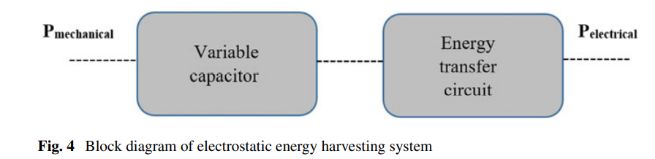
Energy harvesting systems
Electrostatic Energy Harvesting
The electrostatic converters are mainly consisting of an energy transfer circuit and variable capacitors.
The two plates of the variable capacitor are kept at some distance and mechanical stress is applied at one end of the capacitor plate, which changes the value of the capacitor and this variation in capacitance value results in the change in voltage or current.

Slide 37
Energy harvesting systems
The output from the energy transfer circuit can be utilized directly by a load resistor or it can be stored in the form of chemical energy also
simple, compact, easy to design and integrate with microelectronics, compatible with micro electromechanical (MEMS) systems but the only limitation is the small quantity of power generated.

Slide 38
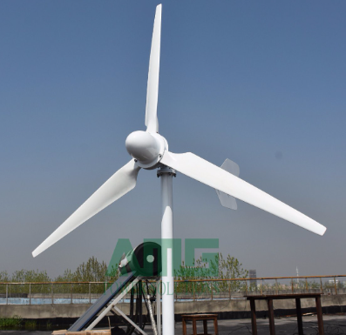
Energy harvesting systems
Wind Energy Harvesting
The wind power can be harvested with the help of large wind turbines by mechanical means and converted into electrical energy.
Basically, two types of wind conversion, one is fixed speed type and another is variable speed type.
The fixed speed system is directly connected to the grid whereas the variable speed system works as an electronic interface.
The wind turbines are categorized
as the vertical axis and horizontal axis type.

Slide 39
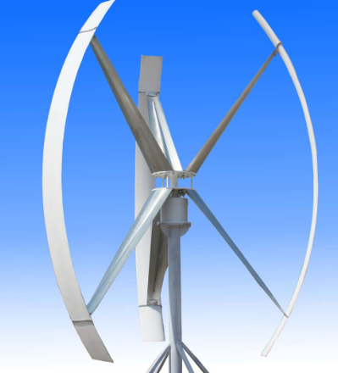
Energy harvesting systems
Vertical Axis Wind Turbine
(a) The main rotor shaft is kept perpendicular or in the vertical position with respect to the ground.
(b) The replacement and repair of generator and gearbox are easy as these components are near to the ground.
(c) The blades of these turbines need not be pointed as it will receive wind from all the directions.

Slide 40
Energy harvesting systems
Horizontal Axis Wind Turbine
The main rotor shaft is kept in parallel or in a horizontal position with respect to the ground.
The most commonly used horizontal axis wind turbines comprised of two or three blades.
When the wind blows a low-pressure air is produced at the back side of the blade and high-pressure air in the front side of the blades.
A rotor shaft is connected to the generator
and this electrical generator harvests
the wind energy by converting into mechanical
and then to DC current.

Slide 41
Energy harvesting systems
RF Energy Harvesting
The RF energy conversion also known as wireless energy harvesting (WEH) can be realized with the help of a device called rectenna.
The rectenna senses the electromagnetic waves available in the environment with the help of a compact electronic circuitry.
Rectenna is basically comprised of an antenna which senses the electromagnetic signal, rectifying circuit for converting RF signal to DC waveform, a matching circuit to match the impedance of the antenna and rectifying diode, and a DC pass filter for smoothening and removing unwanted ripples from the output waveform.
Hence, the rectenna is an emerging easy access energy solution to M2M communication for IoT devices.

Slide 42
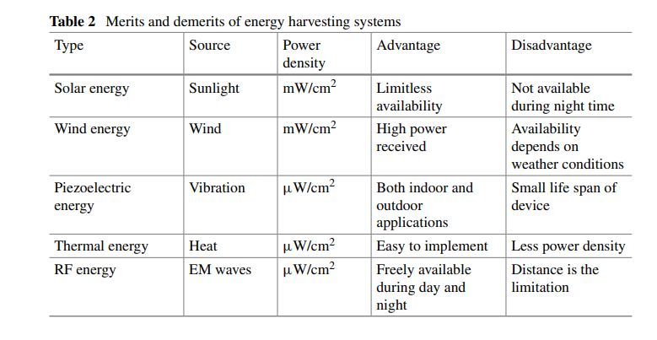
Merits and demerits of energy harvesting systems

Slide 43
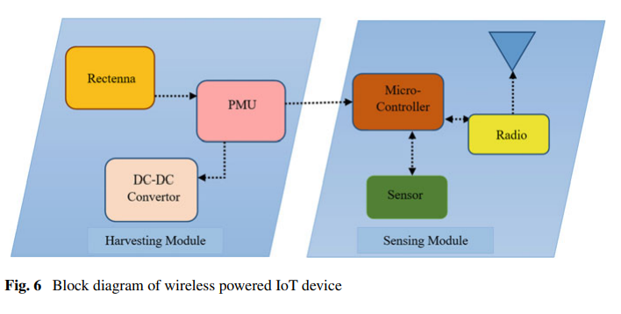
Harvesting Module

Slide 44
Harvesting Module
It is mainly consisting of three blocks:
a rectenna for RF-DC conversion,
DC-DC converter and
a power management unit (PMU).
The sensing node directly utilizes the harvested energy and when this consumption is less than the total amount of harvested energy, the storage component stores the excess quantity

Slide 45
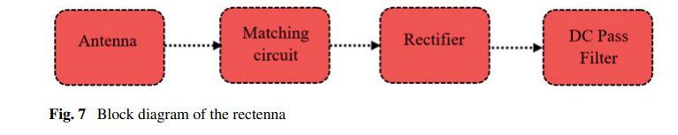
Harvesting Module
Rectenna Model
The first block is a receiving antenna which senses the electromagnetic waves from the surroundings.
A matching circuit is present which matches the antenna impedance with the impedance of the rectifying diodes
rectifying circuit for converting RF signal to DC waveform
The unwanted harmonics generated due to the nonlinear behavior of the rectifying diodes will be blocked by the DC filter

Slide 46
Sensing Antenna
Sensing Antenna
The different types of sensing antenna can be
Monopole
dipole
folded dipole
Fractal
Bowtie
Slot
and microstrip patch antenna
The antenna must have high gain and multiple radiating band characteristics

Slide 47
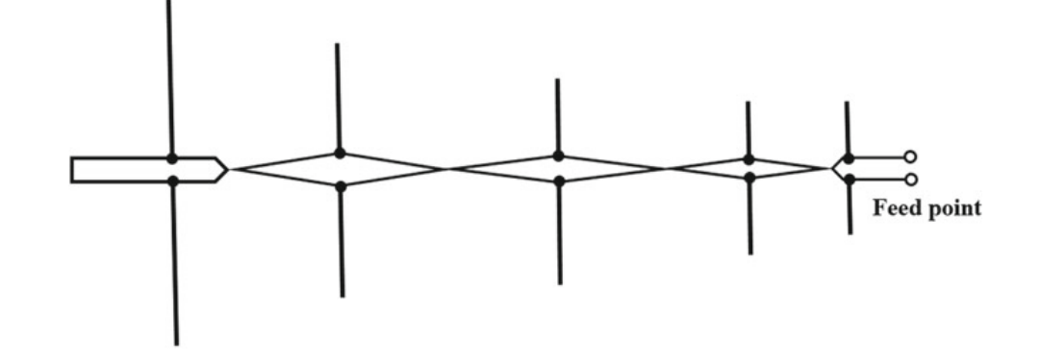
Sensing Antenna
Log Periodic Dipole Antenna
Fig: Layout of the log periodic antenna

Slide 48
Log Periodic Dipole Antenna
It is an array of dipoles with variation in size and the last dipole is considered as the largest element whereas the first dipole at the front end is the smallest element.
The antenna elements are connected in parallel to each other and with feedline and it is very commonly used for the purpose of broadcasting.

Slide 49
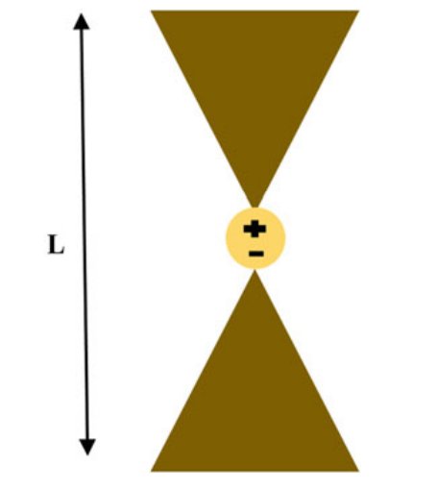
Bowtie Antenna
Bowtie Antenna also called as butterfly antenna acts as a high pass filter in the rectenna systems.
The bowtie antenna shows a higher gain at low frequency.
a feeding line is present in the center of bowtie to excite the antenna.
This bowtie antenna shows similar radiation behavior as of dipole antenna.
Fig: Layout of the bowtie antenna

Slide 50
Sensing Antenna
Wire Antenna or short dipole antenna
the size of wire antenna is completely dependent upon the wavelength.
A short dipole antenna is a very common and simple type antenna with feeding line connected in the center and its length should be less than the one-tenth of the wavelength.
This antenna is omnidirectional with 90° half-power beamwidth and shows a linear polarization radiation characteristic.

Slide 51
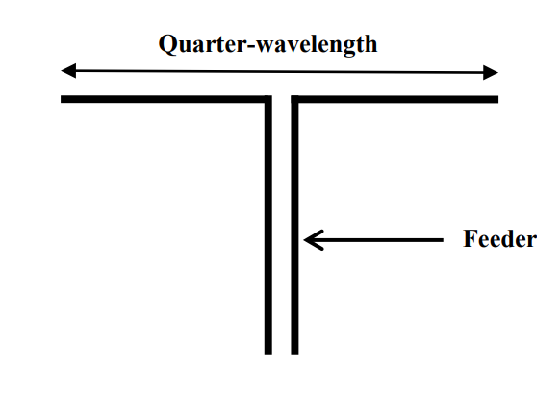
Sensing Antenna
Dipole Antenna
A dipole antenna is an extension of the short dipole and in this antenna, the length of each conductor must be chosen as the quarter wavelength of the operating frequency
Compared to short dipole antenna, the dipole antenna is directional and has a large bandwidth.

Slide 52
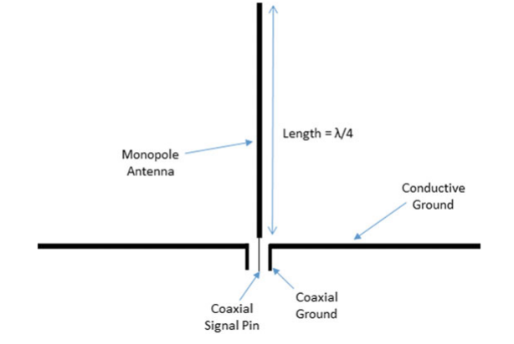
Sensing Antenna
Monopole Antenna
with single pole and consists of a single conductor generally connected in the perpendicular or vertical direction.
antenna size is the half wavelength of the simple dipole antenna
The directivity of the monopole antenna is roughly double the length of the antenna.

Slide 53
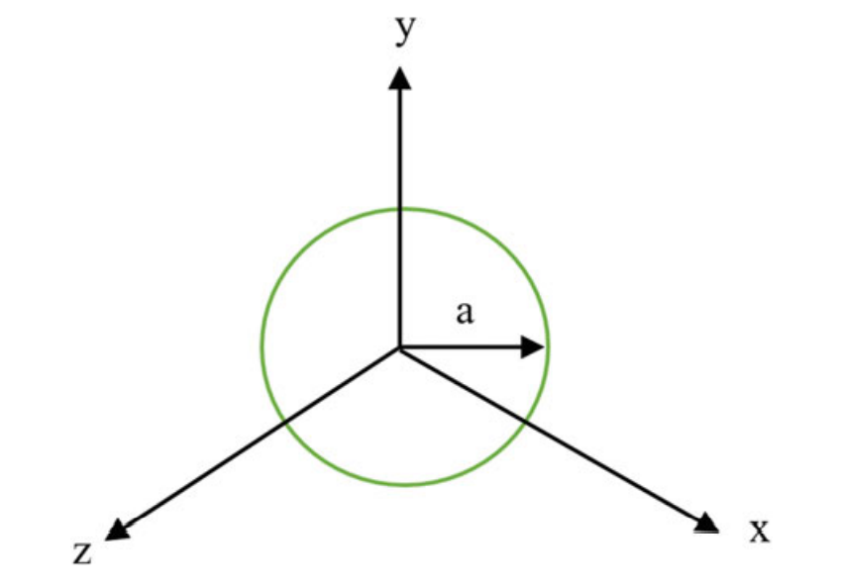
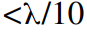

Sensing Antenna
Loop Antenna
The circumference of the loop determines the antenna efficiency similar to monopole where the conductor length measures the efficiency of the antenna.
On the basis of circumference,
the loop antenna is classified
as of two types; one is electrically
small whose circumference and
other type is electrically large loop
antenna whose circumference

Slide 54
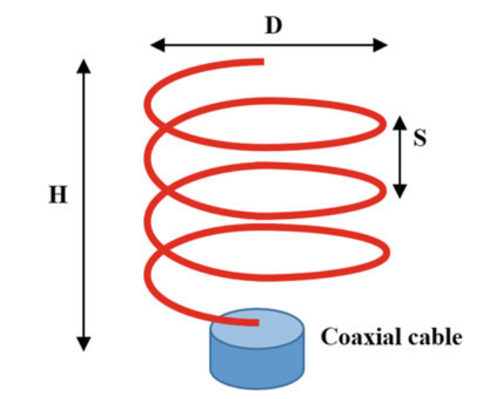
Sensing Antenna
Helical Antenna
The helical antenna is having the shape of a helix and is popularly called as traveling wave antenna.
Here, D is the diameter of the single turn,
N is the number of turns, H is the height of antenna,
and S is the distance between two consecutive turns.

Slide 55
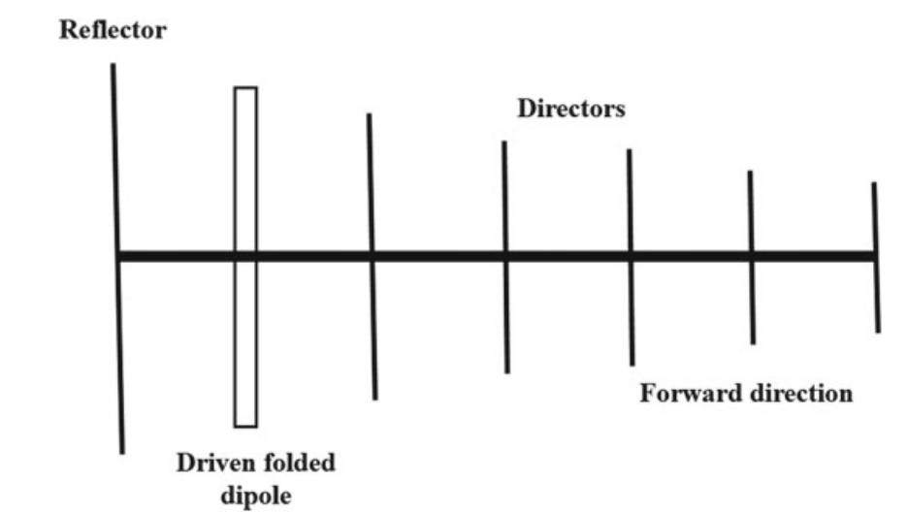
Sensing Antenna
Yagi–Uda Antenna
This antenna is the most
popular antenna type and
can be easily seen on the
rooftop of the small and
large building used mainly
for the purpose of
broadcasting.

Slide 56
This antenna is a simple high gain antenna consisting of an array of components connected in parallel to the feeding element.
This antenna has a single feeding element generally present in the middle of the array and all other parasitic elements help in transmission of power in one direction.
In this antenna, the length of the reflector is kept slightly larger than the feeder; the main purpose of this length variation is to create a phase difference so that it can act as a traveling wave antenna.
The other elements are called directors and their number ranges from one to twenty. The Yagi–Uda antenna used for receiving TV signals in home

Slide 57

Sensing Antenna
Spiral Antenna
small size and good sensing capability
wide bandwidth
High frequency range of 1–18 GHz is popularly used in lightweight fighter aircraft.
Spiral antennas are derived from dipole antenna by turning its arm either in a circular shape or rectangular shape and their feeding element is present in the center of the antenna.

Slide 58
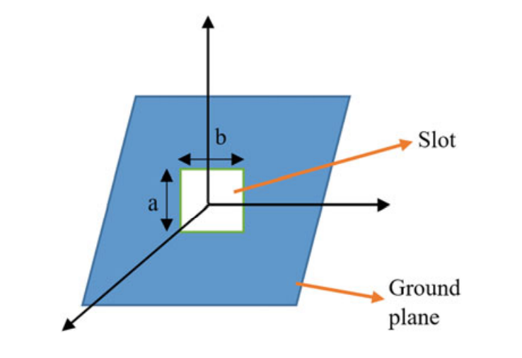
Sensing Antenna
Slot Antenna
Slot antenna operates well within the
frequency range of 300 MHz to 24 GHz.
A slot is basically a cut of any shape or
size present on the surface of the antenna
a rectangular slot of dimension a × b is
cut from the conducting plane.
After implanting the slot,
the E-field experiences some distortion on the radiating surface, and current across the slot is primarily responsible for changing the radiation mechanism.

Slide 59
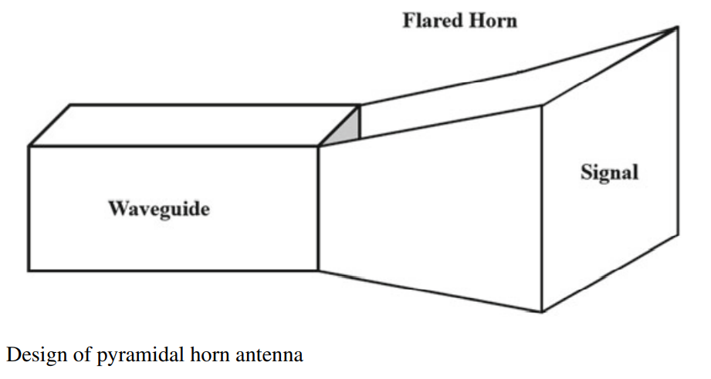
Horn Antenna
Mainly, three types of Horn antennas are in practice:
(a) E-plane Horn antenna: the antenna shape is flared in the E-plane axis.
(b) H-plane Horn antenna: the antenna shape is flared in the H-plane axis
(c) Pyramidal Horn antenna: when the flare is in both E-plane and H-plane axis and this type are most commonly used.

Slide 60
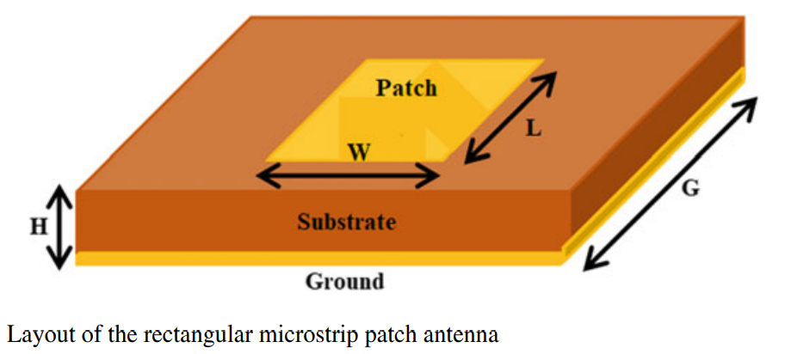
Microstrip Antenna
The microstrip antenna comprised of a metallic patch on the top, a dielectric substrate beneath the radiating patch and a conducting layer at the bottom known as a ground plane

Slide 61
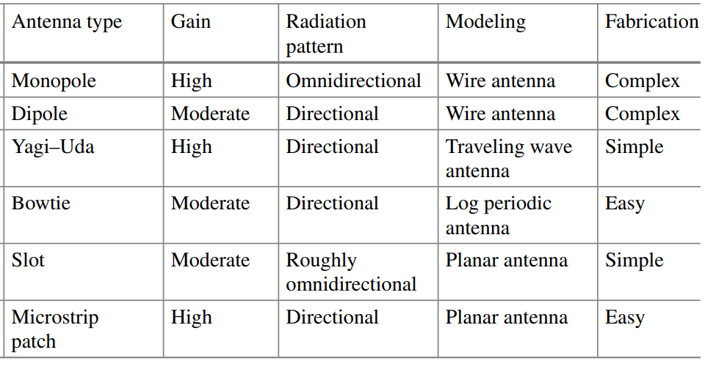
Comparison between different types of antennas

Slide 62
DC-DC Converter
The DC-DC converter is an electronic device that converts one level of direct current to another level of direct current.
It is used in various electronic devices that are dependent upon batteries such as smartphones, tablets, laptops, and charging vehicles.
By means of storing the energy temporarily with an inductor or capacitor, this conversion is affected.
Generally, there are two types of DC-DC convertors

Slide 63
Electronic DC-DC conversion:
The DC level can be stored in either magnetic field component or electric field component in the form of inductor or capacitor.
As per requirement, the stored DC level is released at different voltage levels.
The conversion mode can change the DC voltage level from input to output.
This technique shows an advantage over linear voltage regulation as it does not dissipate the unwanted power in the form of heat.

Slide 64
DC-DC Converter
Magnetic DC-DC conversion:
This type of DC-DC converter stores the energy periodically. The stored energy is released from a magnetic source like inductor or transformer.
The inductor-based converter can be controlled by controlling the duty cycle of the voltage which maintains a constant power at input and output.
The transformer-based converter cannot be controlled but provide a good isolation between input and output.

Slide 65
Wireless Energy Harvesting
Methods
near-field radiation and
far-field radiation.
The far field communication takes place when the object is at a larger distance while near field occurs when the electromagnetic fields are near to radiating object or antenna.
The WEH is implemented through a rectifying device which receives an RF signal from the surroundings and converts it into a stable DC output.

Slide 66
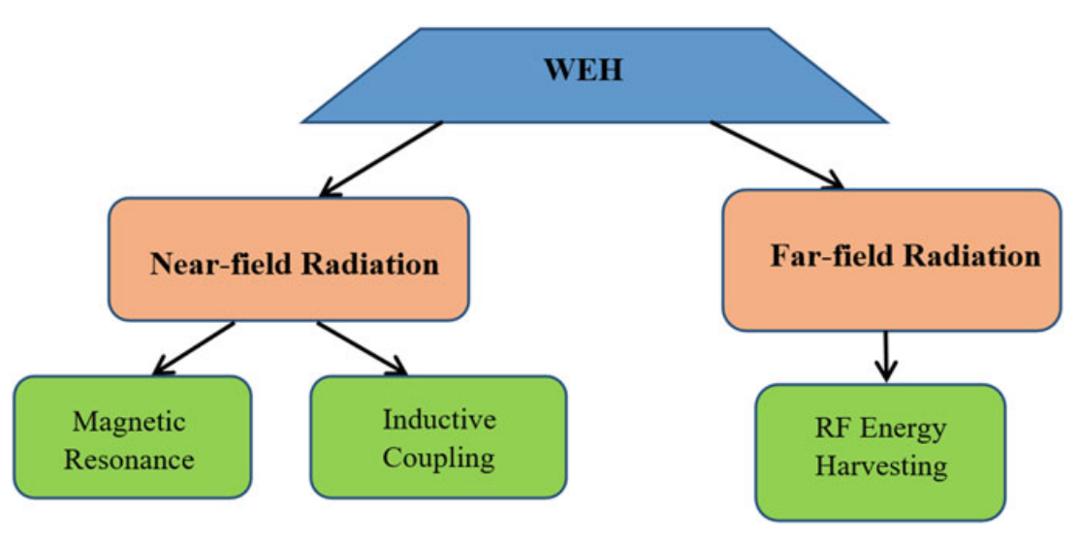
Block diagram of wireless energy harvesting

Slide 67
Near Field Communication
The near field power transfer is much efficient and useful than the far field in the lossy dielectric medium such as biological tissues, sea water and in deep earth.
The far field power transfer experiences a large path loss and most of the radiated power is lost in the transmission.
The near field system is more suitable for biomedical devices
The near field communication is considered robust and provides a secure transfer of data.
The near field communication is considered versatile and is suitable for every situation ranging from personal to commercial applications.

Slide 68
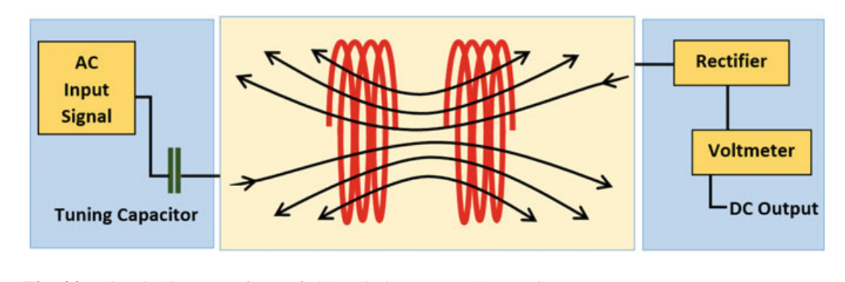
Magnetic Resonance
Circuit diagram of near field radiation energy harvesting system

Slide 69
It consists of two copper coils; the receiving and the transmitting coils.
The transmitting coil is attached with the power supply and the energy is transferred from one coil to another coil.
The transmitting current, in turn, creates a magnetic field, and when the receiver coil comes in the field region of magnetic field, a voltage is induced which is further converted into a DC power by the help of a rectifier

Slide 70
Inductive Coupling
The electrical energy is converted into magnetic energy by means of a primary coil and an EMF is induced in another coil known as secondary.
In the receiver coil, the magnetically induced energy is converted back to electrical energy
The inductive coupling can work only for one device whereas the magnetic resonance can able to connect with multiple devices.
The inductive coupling requires overlapping of the coil as it works on the principle of EMF induction whereas magnetic resonance does not require overlapping

Slide 71
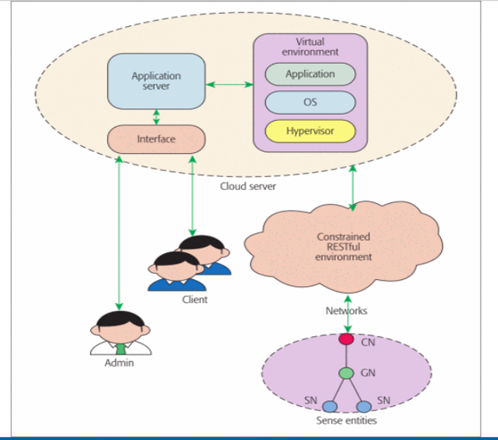
Energy-Efficient IIoT Architecture

Slide 72
Comprised of a sense entities domain, RESTful service hosted networks, a cloud server, and user applications.
Smart devices and nodes are deployed in the sense entities domain. To further optimize energy savings, they are classified into sense nodes (SNs), gateway nodes (GNs), and control nodes (CNs).
The network hosts RESTful web services and connects the sense entities with the cloud server.
Processing and computation for the extracted data from the sense entities domain are also made on the cloud server.

Slide 73
Sense Entities
IoT networks involve sensor nodes and smart devices that are Internet Protocol (IP) enabled and RFID attached.
sensor nodes have strict energy constraints due to their dependence upon batteries.
SNs collect the desired information data from their interested area and send them to GNs. Then GNs store the data in buffer and forward them to CNs.
CNs work as the manager to allocate resources under them and redirect the aggregated data to the networks. Allocation of SNs to specific GNs is also decided by the CNs.

Slide 74
RESTful Service Hosted Networks
RESTful service networks may serve as a bridge between physical sense entities and virtual objects.
They receive the specification data from the sense entities side, such as product ID, device IP address, or device features, and notify the cloud sever to create the virtual objects with the semantic description of the sense entities.

Slide 75
Cloud Server
The cloud server includes the following two components.
Virtual Environment
The data harvested by SNs are in large volumes and raw form.
Thus, it is necessary to store, compute, and analyze them and extract interpretable information.
The virtual environment uses storage and analytical technologies with the aid of the cloud computing platform

Slide 76
Application Server and Interface
The application server allows SNs to communicate with the client through the interface or via direct access from the admin.
The registry is made by tracking the services and physical entities that are available within the entire loT.
The server interface works as a protection of the sever, preventing direct access from the client application

